Slide 1



PROJECT TITLE : SMART TRAFFIC MANAGEMENT SYSTEM
PROBLEM STATEMENT
Congestion is particularly associatesd with motorization and the diffusion of the automobile,which has increase the demand for transportion infrastructure.however ,the supply of the transportion infrastructure
has often not been able to keep up with the growth of mobility.
OBJECTIVE
Objective of proposed system is to improve efficiency of existing automatic traffic signaling system. The system will be image processing based adaptive signal controlling. The timing will be calculated each time change automatically depending upon the traffic load. Proposed system will be functioning based on traditional system along with automated signaling. System will have artificial vision with the help of digital camera mounted on motor for its rotation to face lanes and sense the traffic on the road. The mission of a traffic signal program is to provide good basic service that satisfies the goals of the agency and regional partners involved in transportation systems management and operations (TSM&O).
SMART TRAFFIC MANAGEMENT SYSTEM

Slide 2
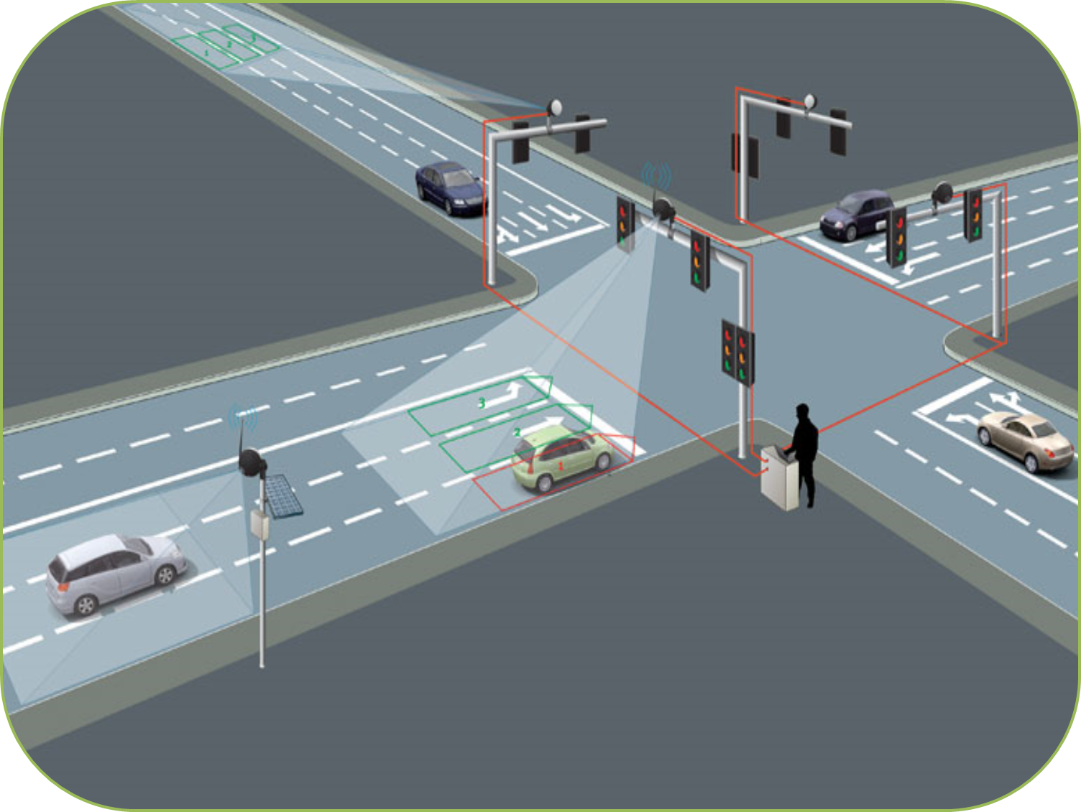



Slide 3
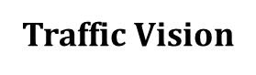
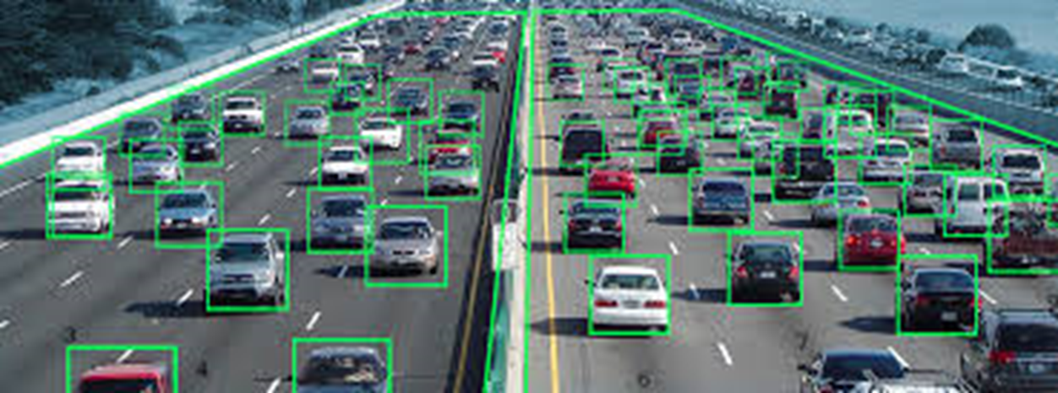
Traffic is one of the major problems in all developing countries. As development is being done and the economy is pumped with money, the number of vehicle owners is skyrocketing. It’s getting difficult for authorities to manage traffic in spite of thumping efforts of government.

Slide 4
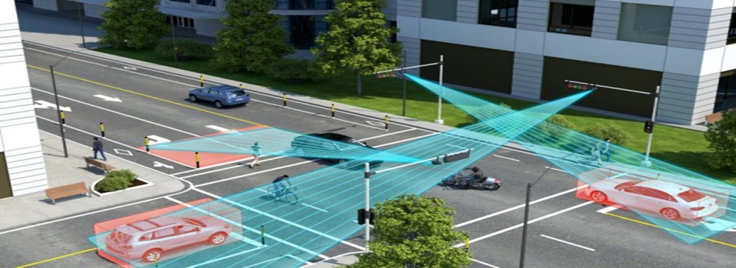
Government is trying its best to ensure swift movement of traffic on roads by constructing wider roads, flyovers, underpasses and expressways etc. But, giving wider roads to the burgeoning number of vehicles is not enough. You must ensure safety on roads along with traffic management and it can better be achieved by SMART TRAFFIC MANAGEMENT SYATEM(STMS).

Slide 5
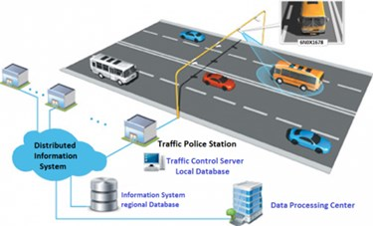
Data Collection
Varied hardware devices are installed to collect data from different sources.This hardware includes automatic vehicle identifiers,sensors,camera,and GPS based automatic vehicle locators etc. The received data such as traffic count,travel speed,vehicle weight,surveillance,and delays etc.is fotwarded to the master controller.

